Slide 1
Replication of Roberts et al.’s “Structural Topic Models for Open-Ended Survey Responses”
Kaylynn Driggers

Slide 2
Introduction
Problem: Open-ended survey responses are rarely analyzed in political science because they are expensive to code and usually rely on human coders
Roberts et al. (2014) argue that STM offers a semiautomated alternative that can incorporate covariates (party, gender, treatment assignment) and can create topics and estimate treatment effects.
Paper tries to show that open-ended responses can be analyzed systematically, which makes text analysis more efficient.

Slide 3
Methods
Authors used multiple datasets to test STM:
Gadarian immigration experiment
Rand public goods experiments
ANES most important problem data
In using STM, the authors first used semantic coherence and exclusivity plots to determine best models and then inspected the content of the texts to check that the estimated topics were fitting. After multiple tries with candidate models, they chose the one that best fit.

Slide 4
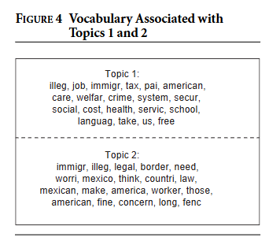
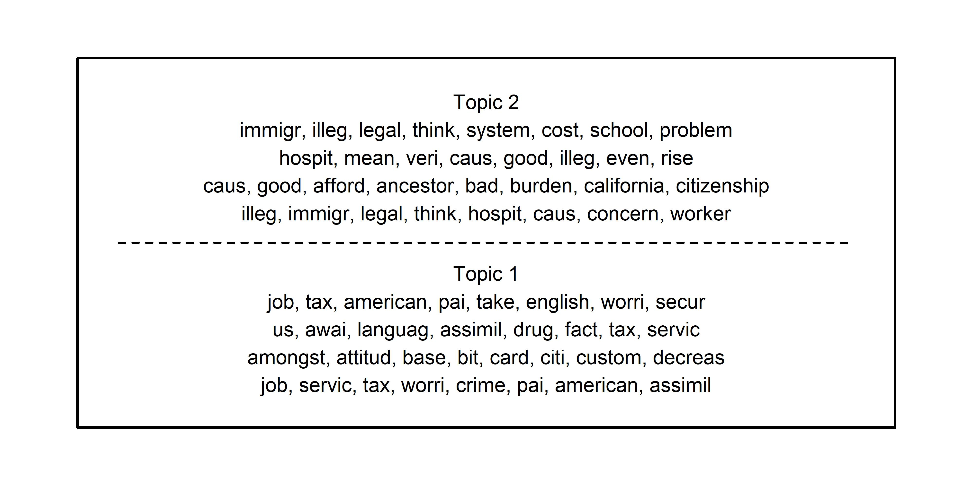
Gadarian Experiments: Figure 4: Vocab in Figures 1 and 2
Replication
Original

Slide 5
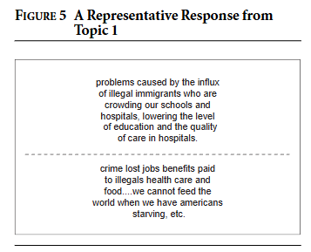
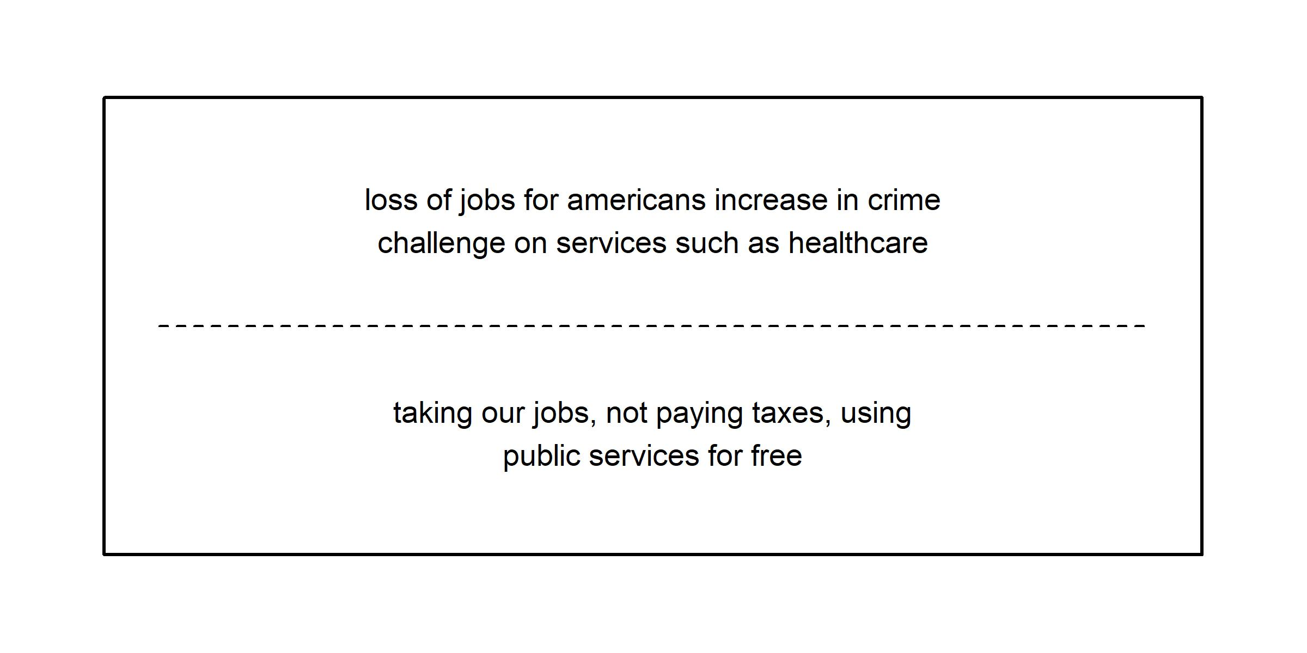
Gadarian Experiment: Figure 5: Representative Response From Topic 1
Original
Replication

Slide 6
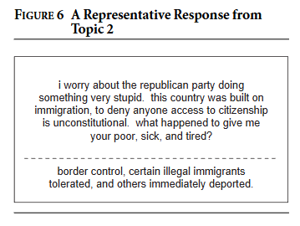
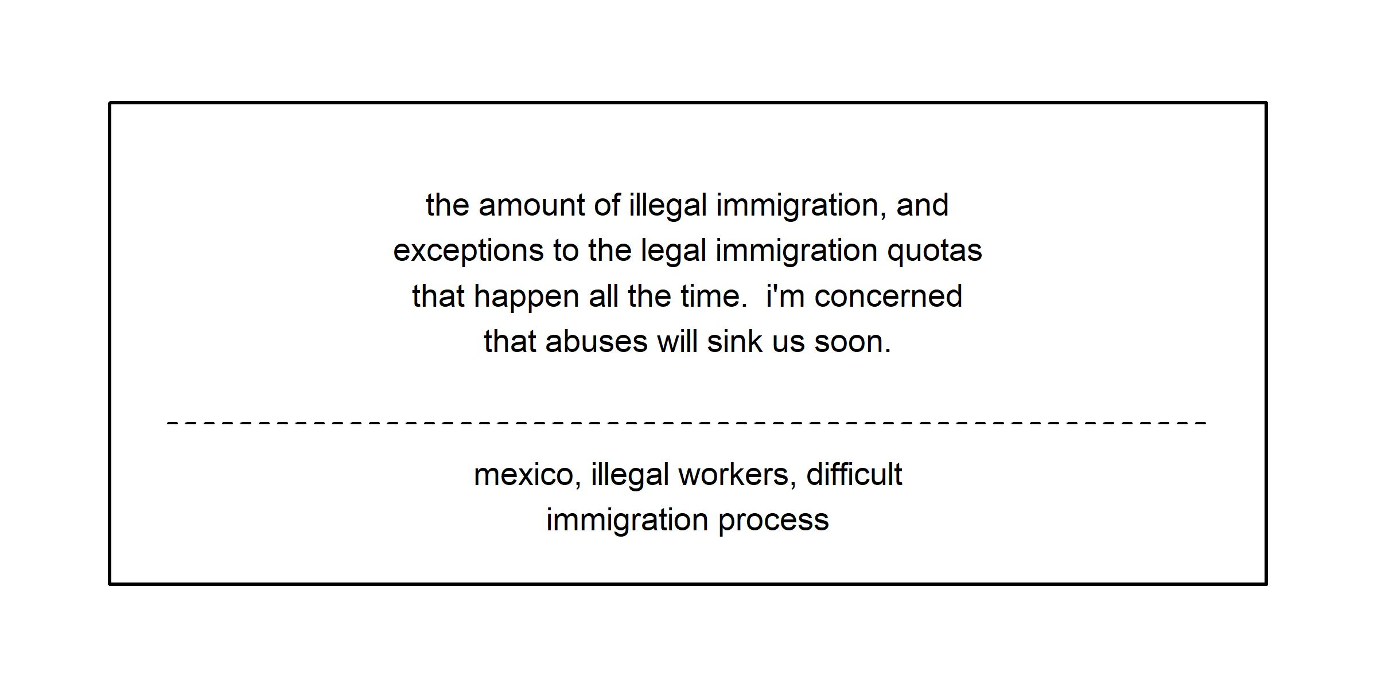
Gadarian Experiment: Figure 6: Representative Response from Topic 2
Original
Replication

Slide 7
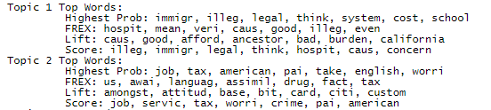
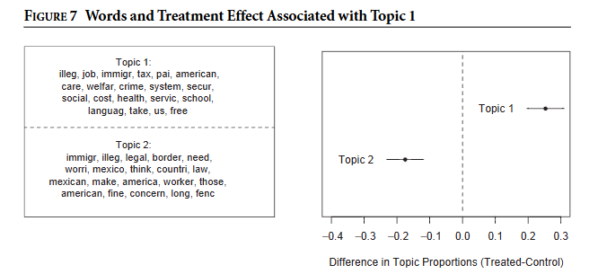
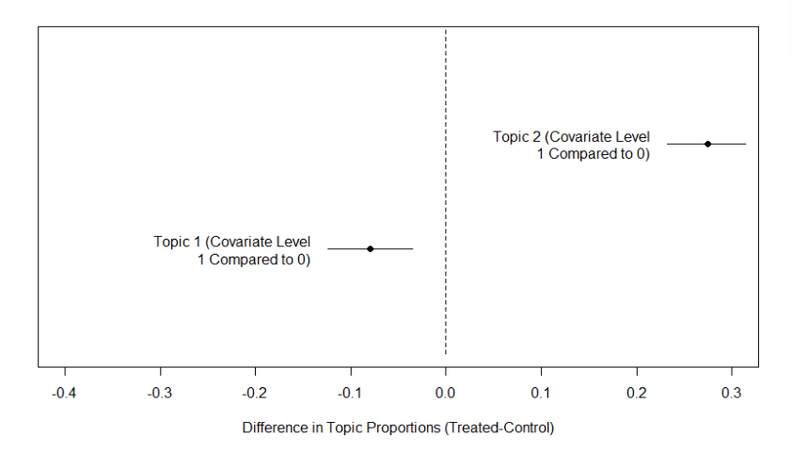
Results: Gadarian Experiments: Figure 7
Replication
Original
Notes:
Topics 1 and 2 are flipped, because my Topic 1 is equivalent to their Topic 2 and my Topic 2 is equivalent to their Topic 1

Slide 8
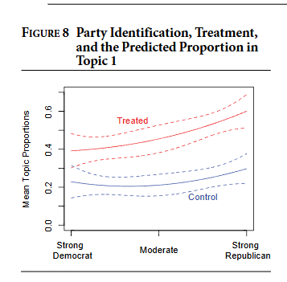
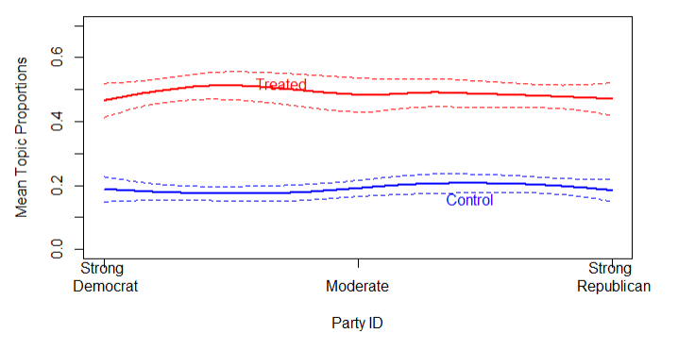
Gadarian Experiment: Figures 8
Replication
Original

Slide 9
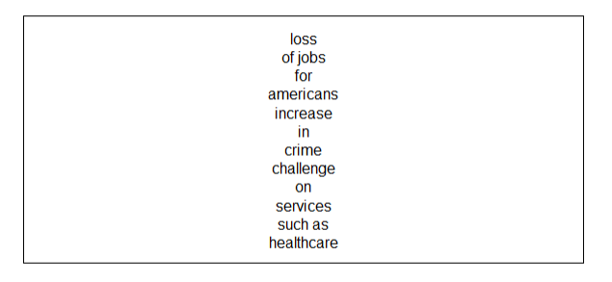
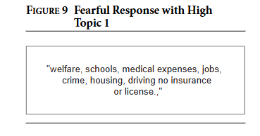
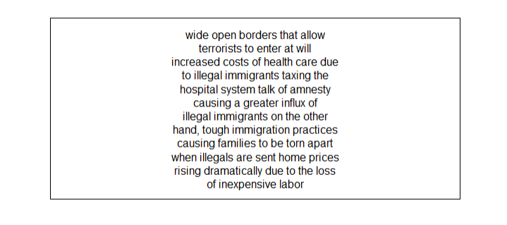
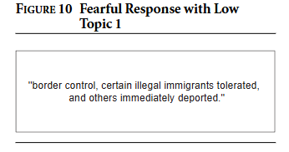
Gadarian Experiment: Figures 9 and 10
Original
Replication

Slide 10
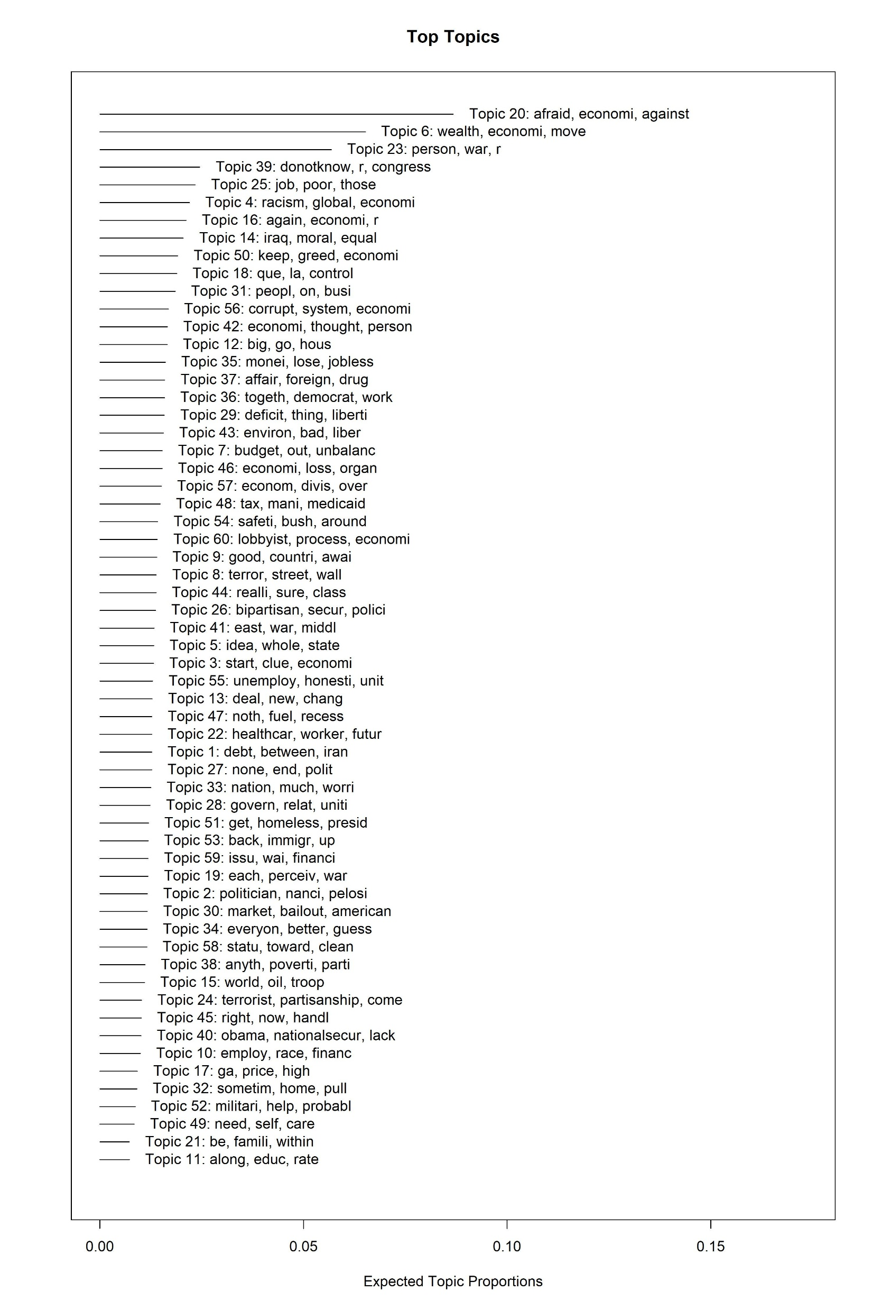
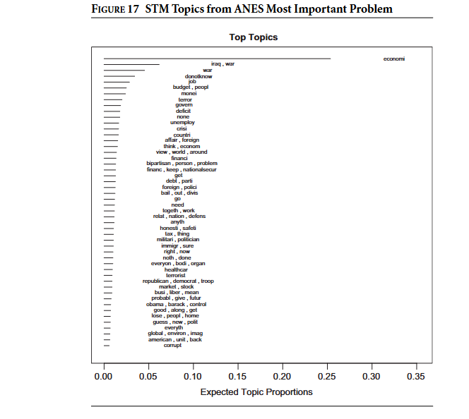
Results: ANES Most Important Problem: Figure 17

Slide 11
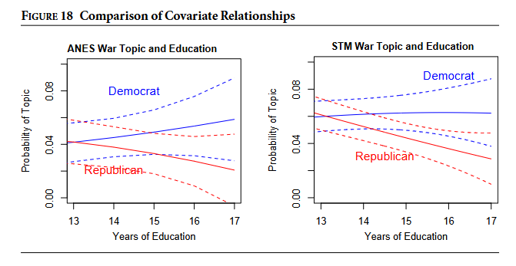
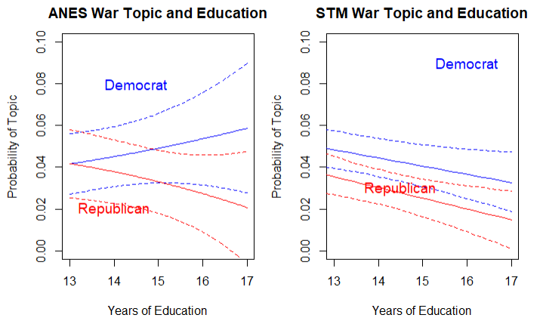
ANES Most Important Problem: Figure 18
Original
Replication

Slide 12
Replication Autopsy: What did I learn?
Archived scripts relied on helper files from the developer’s computer and old function names (so I had to do a bit of translating)
Replication code appeared to be using a development STM version
I chose models that were as close as possible to those chosen by the authors, but they were not exact
I had to do a bit of digging and compatibility checking to match functions with archived versions of STM

Slide 13

Replication Autopsy: What worked
I was often able to replicate the substantive patterns from the original paper
When using the modern version of STM, many of the functions were simple to update (just slightly changed names)

Slide 14
Replication Autopsy: What did not work
The original data relied on developer helper scripts that were inaccessible/not included in the replication package or on the developer’s Github
Similarly, the code relied on a development/early version of STM (which I also attempted to recover, but was unsuccessful)
Even when using the original seeds and models, exact model replication was not always possible, which led to different results
There was internal inconsistency in the metadata and vocab files, which I could not fix without adding new/random data to approximate (which is straying pretty far from replicating)

Slide 15
Replication Autopsy: Why the Rand replication failed
I attempted to replicate the workflow for the experiment, but was unable to run the model using the files in the replication package.
The issue was a mismatch across files:
the document and metadata counts and a missing document feature IDs in the vocab file

Slide 16
Extension
More transparent model selection
Use new diagnostics to show more clearly why one topic solution was chosen over another
Incorporate explicit stability checks
To show whether similar topics reappear across different seeds and candidate models
Making preprocessing steps more explicit
STM now includes textProcessor() and prepDocuments() and
Better replication packaging
I would include all helper scripts, software versions, and code for every figure (an in organized script) so the paper is easier to reproduce
It may be interesting to make this process more automated, for example:
Create a function that both changes the seed and runs the candidate models itself? And then produces semantic coherence exclusivity plots that I can see and compare all at once.

Slide 17
Conclusion
Overall, I was able to partly replicate the core findings of the paper, but due to the missing replication files and inconsistent/improperly formatted files that were included for the Rand analysis on priming and intuition, I have not beeen able to reproduce a full replication of the paper.

